Slide 1
Inverse Design via Machine Learning
Shengnan Han

Slide 2
Cylinder Unit Inverse Design Using S4

Slide 3
What’s the goal?
Predict radius of the cylinder unit by its spectrum
Research effects of different optimization and learning techniques

Slide 4
How to achieve?
Use Deep Forward Neuron Network to learn from experience E, with respect to the same task T and performance P, and hope the performance of the task improves with experience.
E: Dataset x containing 41 samples’ transmittance spectrums with 50 points extracted, a vector (41, 50) , A vector y containing R_norm with 41 regression targets, a vector (41, 1).
T: Predict R_norm from transmittance spectrum by neuron network
P: Mean square error and comparison between true spectrum and predicted spectrum

Slide 5
Why not other kinds of net work?
Linear regression? Impossible
Convolution network? Not spatial structure
Recurrent network? Not sequential structure

Slide 6
Training process
Go to anaconda

Slide 7
Next Step
Our problems:
Limited in types of spectrum
Limited shapes -> limited types of spectrum
Limited loss function
Limited spectrum precision

Slide 8
How do we overcome them?
Limited shape -> Pixelize shape and produce various spectrum
Limited spectrum precision -> Smaller steps, greater resolution -> longer data generating process, need workstation or Accre!
Limited loss function choose -> IDK

Slide 9
Pixelize Shape
What’s shape look like?
Consideration: Random shape not acceptable
Hard to generate the real unit (sharp angle, narrow edge, etc)
Hard to test the result (Using S4)
When light propagate through the shape from y-axis and x-axis, they should produce the same spectrum
X-axis and y-axis must be the same shape! (Circle, rectangle)

Slide 10
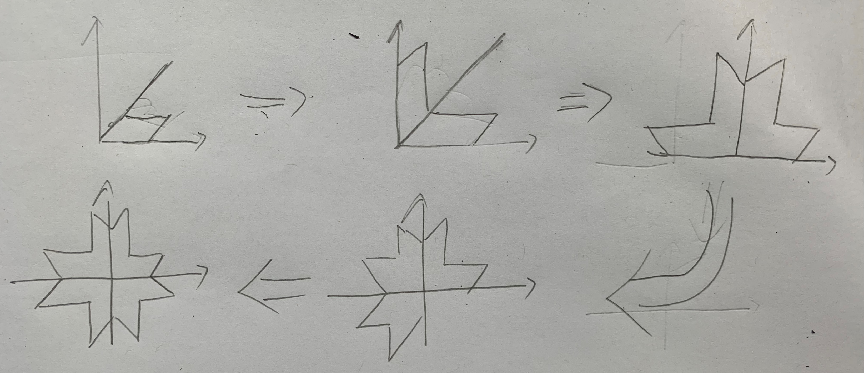
How do we generate the shape?
SetLayerPatternPoly function in S4
Generate poly by connecting coordinates in sequence
Algorithm: generate 1/8 of the shape, reflect by 45 degree axis, rotate the shape through the rest of 3 quarters

Slide 11
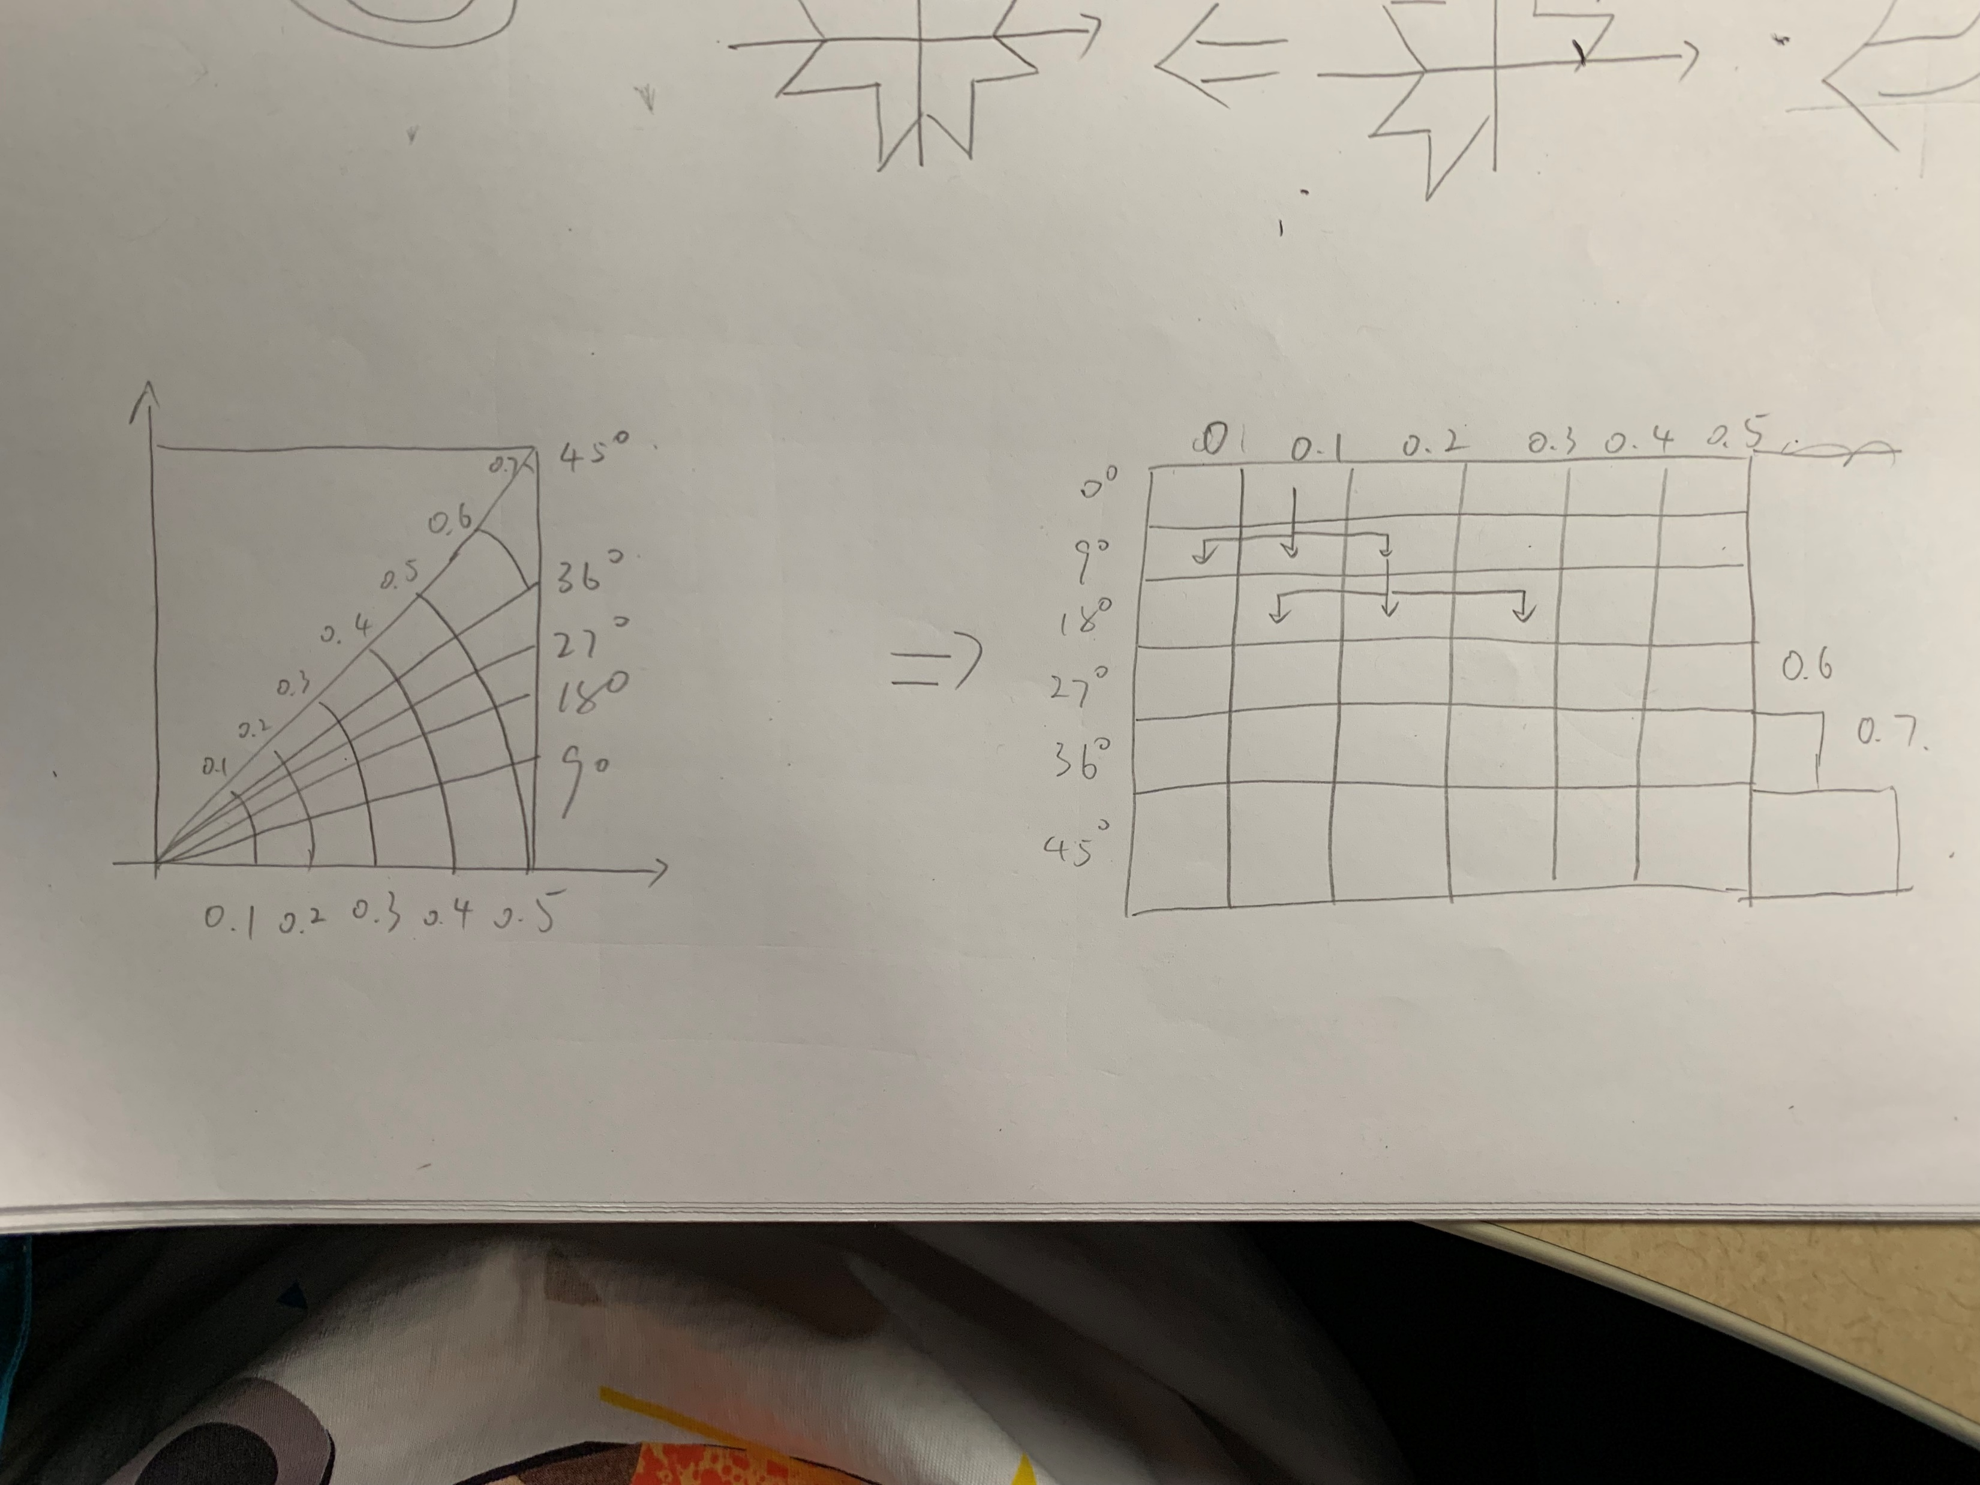
How do we generate the 1/8 shape?
Use the polar coordinate instead of xy coordinate (normal pixel thing)
Polar coordinate looks like (length, angle) (l, alfa)
Translate polar coordinate x = l * cos(alfa), y = l * sin(alfa)
Why we use polar coordinates?
Easy to make a closed graph
Easy to make a circle and other shapes
Easy to make multiple different kinds of shape

Slide 12
How do we make multiple graph?
Depth first search!
Consider this as a 2D matrix.
Restrict search process that it only search the points near itself to avoid sharp angle that impossible to be made in the real world

Slide 13
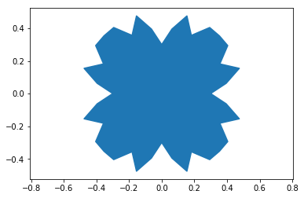
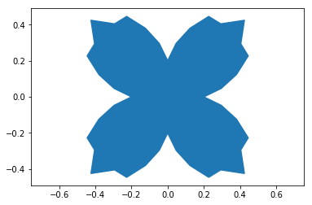
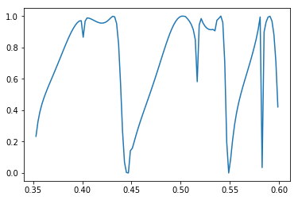
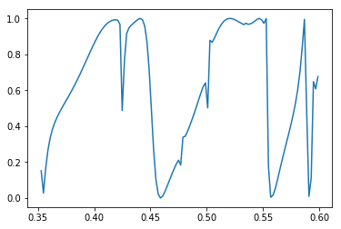
Samples of Random Generated Poly

Slide 14
Possible improvement
More dense polar coordinates
Activate and deactivate angle lines
Complex poly structure requires heavy computations -> use workstation or Accre to accelerate data generating process

Slide 15
This week
Generate 1024 sample (Approximately 3.5 days on my computer)
Meanwhile update algorithms
Training and see the result.

